Slide 1
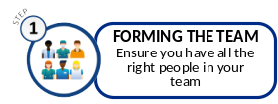
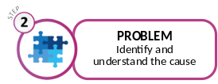
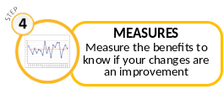
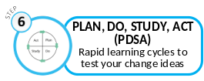
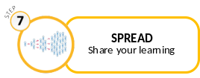
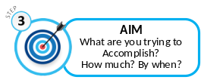
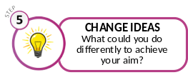
Power Framework Project Tracks
7 Steps of QI
Improvement (QI) Project Stages​
Feasibility
Scoping
Implementation & Spread
Closure
Test & Learn
Digital Project Stages​
Feasibility
Scoping
Delivery
Closure
Configuration
Pilot
Standard Project Stages​
Feasibility
Scoping
Delivery
Closure
Generic Programme Stages (earliest project start and latest project finish)
Concept
Initiative
Execute
Benefits
Closure

