Slide 1
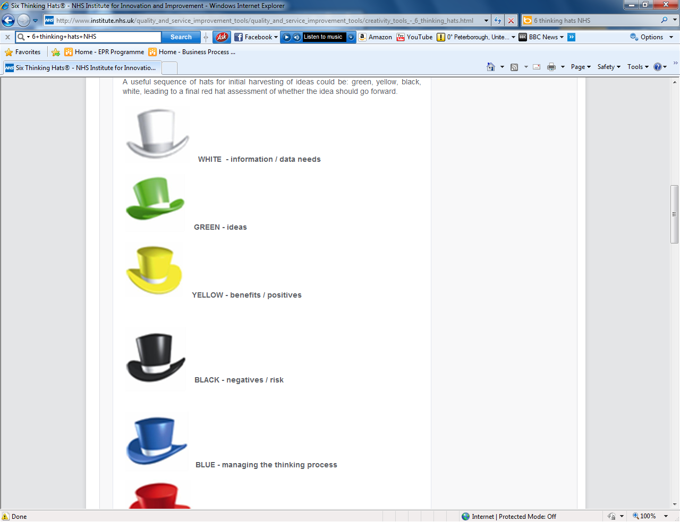
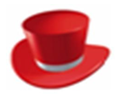

De Bono’s Six Thinking Hats
Green Hat = Creative thinking:
Go beyond the obvious and the familiar. Strive to think of new ideas.
What are the possibilities? Are there other ways of doing this?
Red Hat = Emotions:
Feelings, hunches and intuition.
What are my feelings right now? What does my intuition/gut reaction tell me?
Yellow Hat = Logical positives:
Optimism, benefits, being constructive
What are the benefits/positives? Can this be made to work?
Black Hat = Logical negatives:
Flaws, barriers, mismatch, risks dangers
What could be the possible problems, difficulties, risks?
White Hat = Information:
Neutral and objective, assessing relevance & accuracy of information
What are the facts? Is anything missing? How can we verify this?
Blue Hat = Summarised thinking:
Consider all the ideas you have come up with. Draw conclusions and opportunities
What is our next step or decision?
Version: V1.0
Date: 06/12/2021
Author: Marie Little, Senior Improvement Advisor

