Slide 1
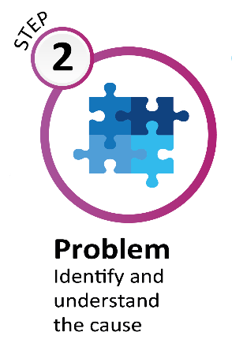

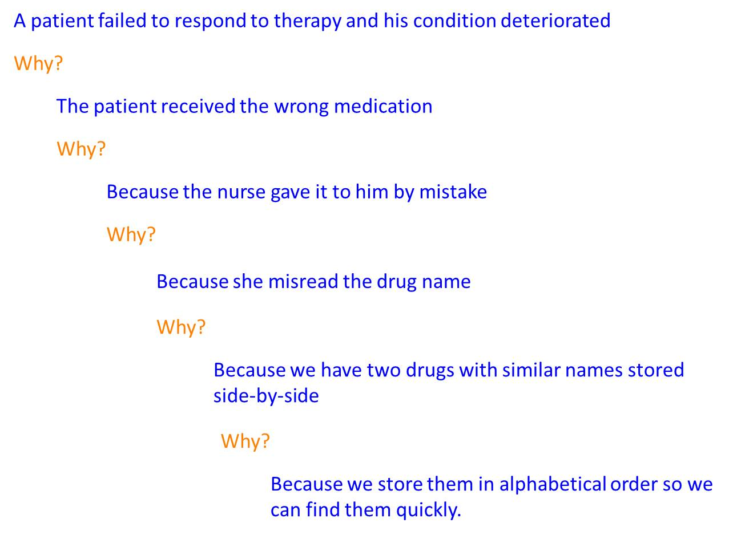
Step 2: Understanding the problem
5 Whys
Notes:
Root cause analysis

