Slide 1
Rapid listing
Stakeholder Mapping & Strategy
CPIG
VNGC
Combine CPIG & VNGC
Power-Interest
Grid
Comms Plan
Notes:
A roadmap to effective stakeholder mapping and strategizing.

Slide 2

Rapid Listing
Rapidly list as many stakeholders as possible in 60 seconds
Compare your list with a colleague, adding new stakeholder as they occur
Move from pairs into groups of four and repeat last step
Finally ask the whole team to make a joint list
IT
PMO
Etc
Patient
Staff
NED’s
Etc
CCG
Etc
Etc
Etc
QI Team
Etc
Etc
PALS
Etc
Etc
WSL
Etc
Etc
CQC
Notes:
Rapid listing
One of the quickest ways and most robust techniques for identifying stakeholders at the start is to:
Gather the core ream together
Clarify the meaning of stakeholder on the change and why is is important that the team does not miss anyone
Get each individual to make a rapid person list of everyone they can think of, give them between 1 – 3 minutes to do this
Pair people off and ask them to compare their list, adding new stakeholder as the occur to them
Move these pair into group of four and repeat last step
Finally ask the whole team to make a joint list
This works well as a technique because it exploits the creativity of groups and word association. Keep a running list of stakeholders, ideally whether others can access/add others a necessary. The list of stakeholders then becomes a key source document for stakeholder profiles and ultimately your communication plan.

Slide 3
CPIG Stakeholder Segmentation Model
Customers
Users of change
Providers
Suppliers of change
Influencers
Governance
Decision makers of change
Influencers of change
Patients
IT
Allocate each stakeholder to a segment
Stakeholders can appear in more than one segment
PALS
CQC
Notes:
CPIG
Segmenting stakeholders is common practice. Segmenting represent a broad group of a type of stakeholder. So by segmenting we can gain a better understanding of their different customers. Prioritizing and segmenting stakeholders is in a moment in time. You will have to regularly re-prioritize.
Segmenting helps:
Prioritise stakeholders. As the change continues, there priorities will change. Some stakeholders will increase in importance to the change, whilst others may disappear altogether. For example, in a service redesign, the Service Director begins as a key stakeholder, but during the change, services are moved out of their directorate, and the service director is less interested in the outcome.
Further analysis. By segmenting a subgroup of stakeholders, certain analysis techniques are more appropriate. For example, personas and empathy maps are more appropriate of large groups, whereas power maps are more appropriate for small key groups of individuals.

Slide 4

Stakeholder Radar
IT
Place each stakeholder onto the radar
V
N
G
C
Patient
Vital to engage
PALS
Necessary to engage
Good to have engaged
Courtesy to inform
CQC
Notes:
Stakeholder Radar
The segmenting used previously can be mapped on to a stakeholder radar. In two dimensions, this shows not only the individual stakeholders, but also the view on the level of engagement needed with each of them. From the centre, the different levels of engagement are labelled:
V for viral to engage
N for necessary to engage
G for good to have engaged
C for courtesy to inform

Slide 5

Customers
Providers
Staff
Etc
Estates
Etc
Etc
Etc
IT
Etc
Etc
Assign all stakeholder within the grid
V
N
G
C
Patients
PALS
Governance
CQC
Influencers
PMO
Etc
CCG
Etc
Etc
Etc
WSL
Etc
Notes:
Segmenting and populating the stakeholder radar
The radar can then be segmented into the four domains of customers, providers, influencers and governance. The boundaries of the segmented radar are porous i.e. the stakeholder may straddle more than one domain, and cross to another domain during the life of the change.
Stakeholders are plotted onto the radar, and the primary questions becomes: how close are you to the centre? You can then begin to populate the radar. In the example shown here, the patient is right in the centre, whilst other stakeholders fan out into different domains.

Slide 6

Power-Interest Grid
High
IT
CQC
Patients
Influential Observers:
Keep Satisfied
Key Players:
Engage Closely
NED’s
PMO
Assign all stakeholder within the grid
WSL’s
Power/Influence
PALS
Spectators:
Monitor
Active Players:
Keep Informed
Staff
Estates
QI Team
Low
Low
High
Interested in your change
Notes:
Mapping In two dimensions.
There are many different ways the people have mapped stakeholders across 2 characteristics. One of the most enduring and popular ways is by looking at each stakeholder in terms of the power/influence over the change against their actual interest in it.
Stakeholders can then be plotted onto this grid. Sometimes, the grids can be used for targeting. For example, a powerful stakeholder in ‘influential observers’ needs to be moved to ‘key players’, that is to say, we need them to buy in and to be more engaged more actively. It is just as important to ensure we keep ‘key plays’ in that quadrant and not drift into disinterested. Further, the spectators need monitoring, as they might move into toerh quadrants if a new interest or power base emerges.
Other combinations of the grid axes are:
Trust versus alignment/consensus
Impact of the change on the stakeholder versus influence
Power versus commitment to the change
Energy versus commitment to the change
Change readiness versus commitment to the change

Slide 7
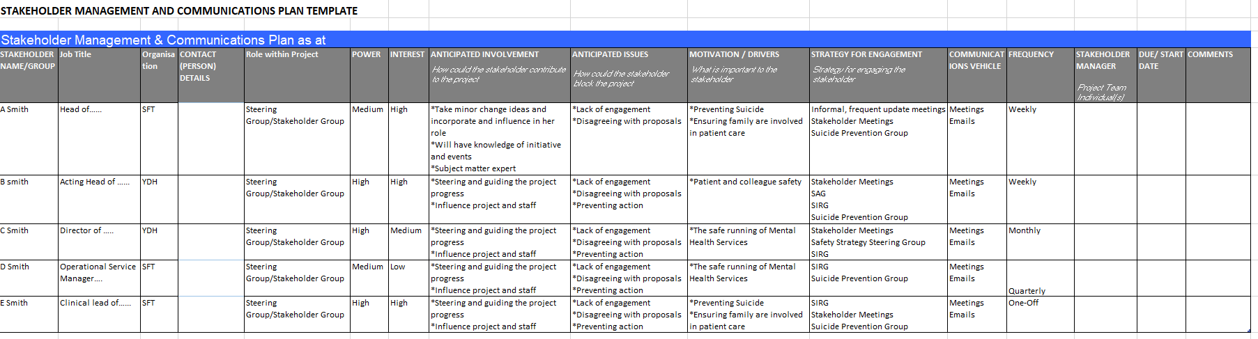
Notes:
Developing a communications plan (when and how we will make it happen)
The information and understanding gained from your stakeholder engagement and communications strategy is the used to develop a communications plan.
Setting out a well considered communications plan will ensure that timely, appropriate and consider activity takes place to deliver all the objectives set out in the comms strategy. It shows who is going to deliver what, when, to whom and how that will be measured, by setting out:
The target audience,
Their power/interest,
Their anticipated involvement & issues (The key messages to communicate),
The objective that is to be achieved for that audience and their motivation/drivers,
The activity that will deliver those messages and achieve that objective,
The timing/frequency of activities,
The person(s) responsible for that communication,
How the activity will be measured.
Effective communication is such a critical aspect of managing change that is needs careful consideration from the very start of the change initiative. Those involved in communicating change should understand the aims of the change initiative, consider the terrain and culture within which change is taking place, and use the information gathered from thorough stakeholder analysis to devise appropriate communication strategies and plans for change.
The planning process needs to include careful consideration of the target audience, the tone and content of the messages, the most effective channels to use, the timing of messages, and how results will be monitored and evaluated. Following a structured approach, as outline in the steps above allows you to develop effective plans to maintain a consistent and effective comminution effort throughout the change initiative.

